Slide 1

CUSTOMER RETNETION
WHAT IS THIS AND WHY IS THIS REQUIRED FOR EVERY ORGANIZATION ?

Slide 2

What is Customer Retention?
Customer retention is the ability to keep customers coming back to your store or website to create repeat business and investment.
Keep your Customer engaged and Build Trust.
Customer Retention ensure customer loyalty.
It is the process of engaging existing customers to continue buying products or services from your business.
In Other Words, Customer Retention means
“to maintain existing customers”

Slide 3

It’s different from customer acquisition or lead generation because you have already converted the customer at least once.
Your probability of selling to an existing customer is at least 40 percent more likely than converting someone who has never bought from you before.

Slide 4

Customer Retention (CR):
Its not a tool its an Art

Slide 5
What are the benefits of CR?
Retained customer tend to buy other services from the same company
Retained customer are known to be less price/cost effective
Positive publicity - Free Marketing 24x7
The probability of selling to an existing customer is 60 – 70%
While the probability of selling to a new customer is 5-20%
Decline Migration rate

Slide 6

Lets Analyse
We have customers feedback for e-Commerce websites
Total 269 customers reply over 70 questions each
Let's do Exploratory Data Analysis for some useful insights

Slide 7
Some Key points to Retain Customers

Slide 8
We will analyze our data
In accounts to these key
points
Data is about to 5 Companies
Amazon
Flipkart
Myntra
Paytm
Snapdeal

Slide 9
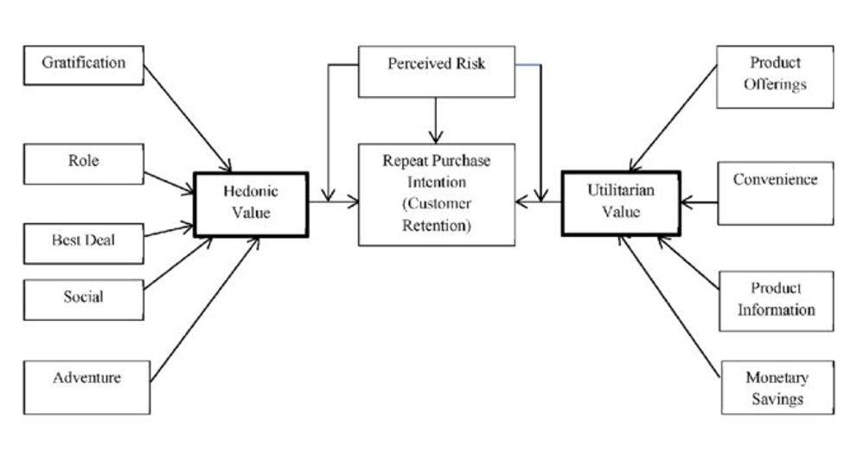

Slide 10
Hedonic Values
Hedonic shopping value reflects the value received from the multisensory, fantasy and emotive aspects of the shopping experience
Hedonic goods are multisensory and provide for experiential consumption, fun, pleasure, and excitement. It comes with good feeling.

Slide 11

Who is our potential customer?

Slide 12
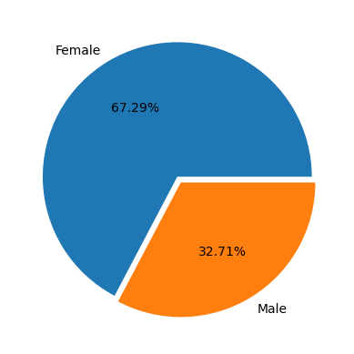
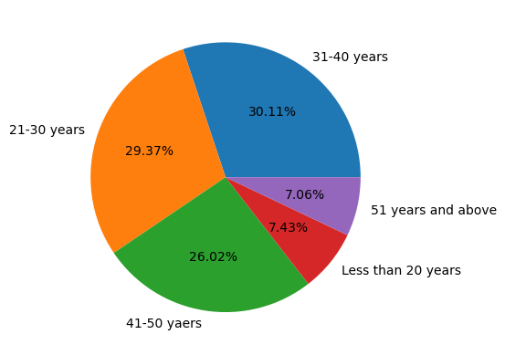
Gender Age
Female are the Potential Customers
21-50 Years are Potential age who covers 85% sales

Slide 13
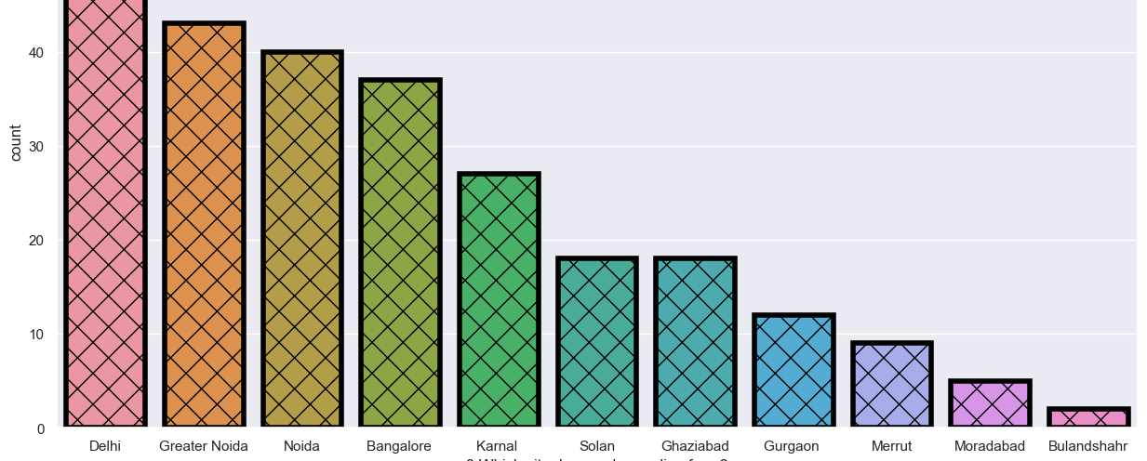
Top 10 Cities For E-Commerce

Slide 14
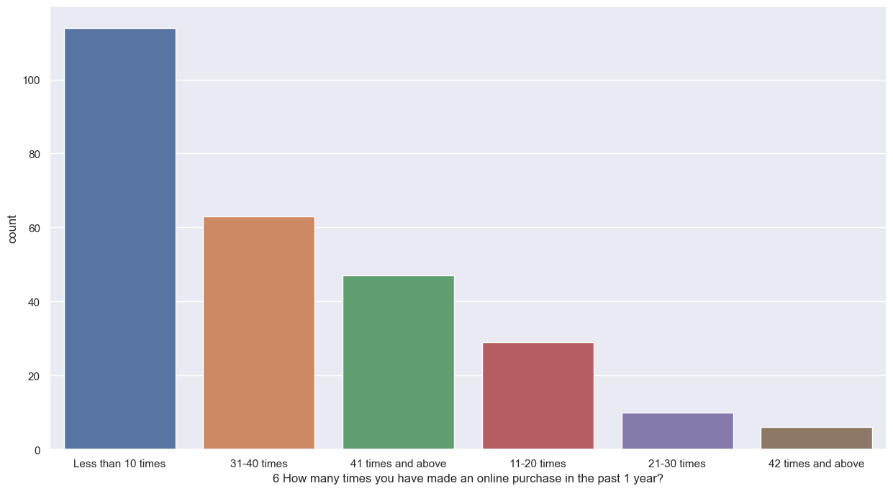
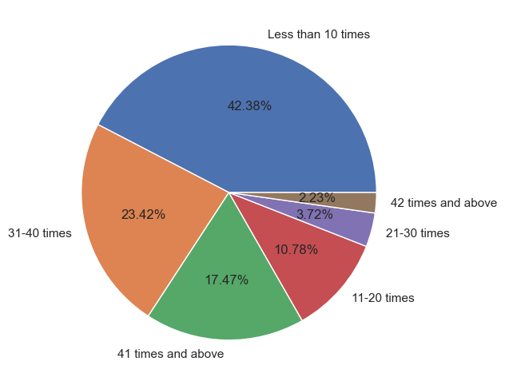
Shopping Pattern
Since how long you are shopping online?
How many times you have made an
online purchase in the past 1 year?

Slide 15
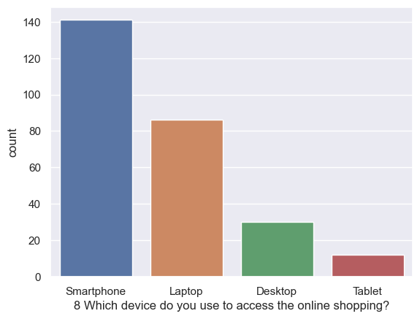
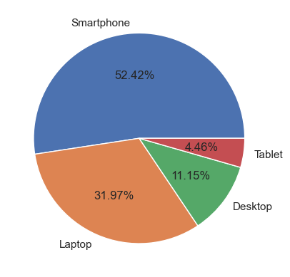
How they do shopping ?
Device Used

Slide 16
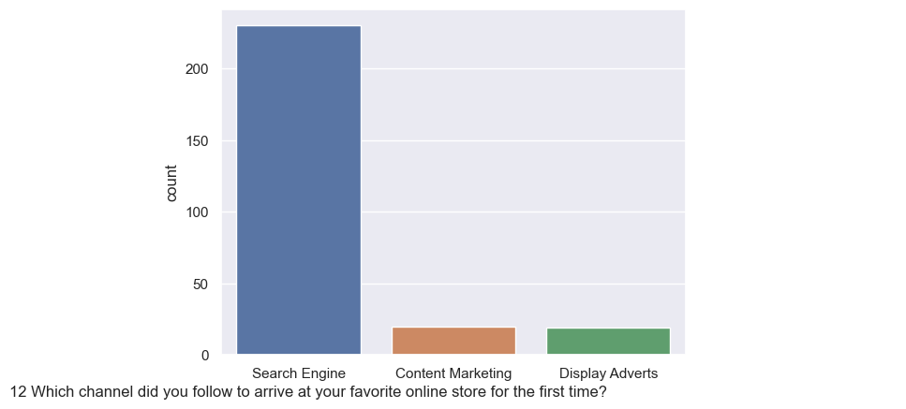
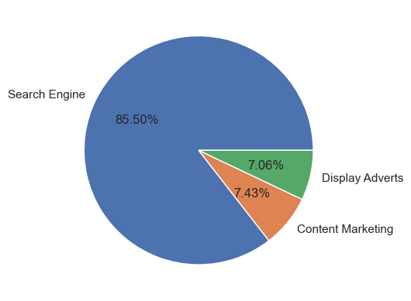
How customer reached to online website?
Customers are someone know what they need so that they search on search engine like Google

Slide 17
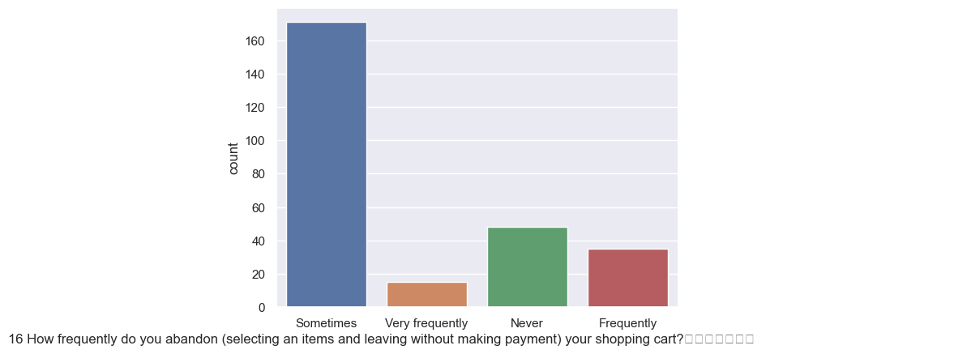
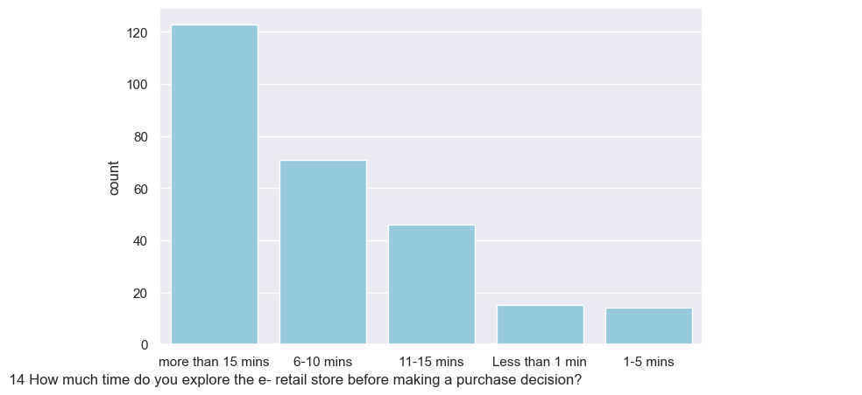
Customer habit on ecommerce
How much time do you explore the e-retail
store before making a purchase decision?
How frequently do you abandon your shopping cart?
Maximum time spend is 15 min on website and sometimes abandon the shopping cart

Slide 18
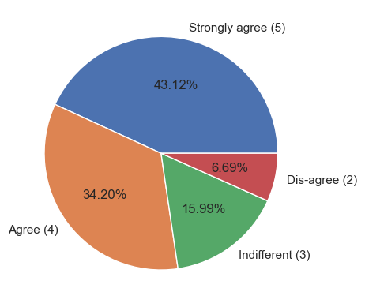
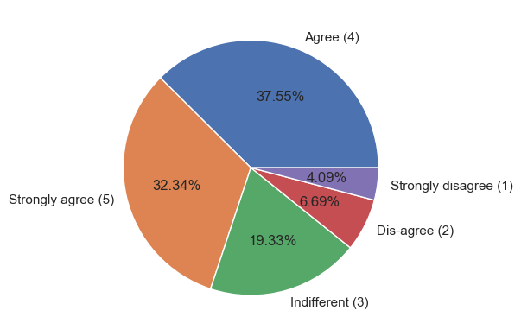
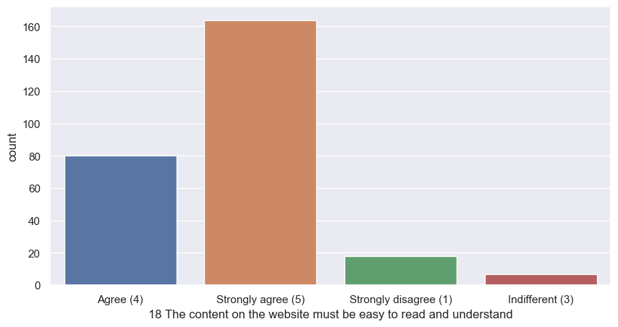
Information of similar product available for
product comparison
Complete information of product and
seller important for purchase decision
Content on website easy to read
and understand
Website Content

Slide 19
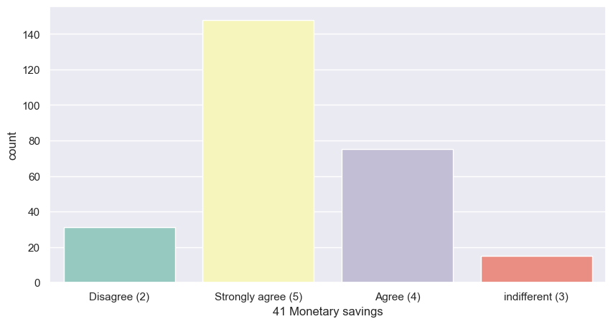
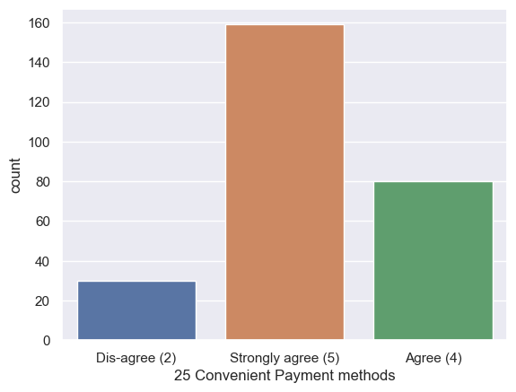
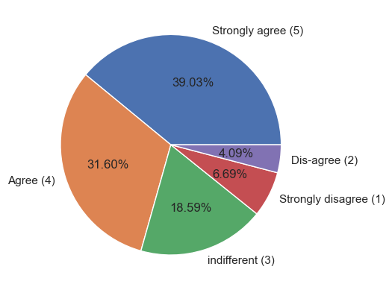
Online shopping gives
Monetary benefit and
discounts
Online shopping gives
discounts
Shopping online provides convenient and
flexible payment methods

Slide 20
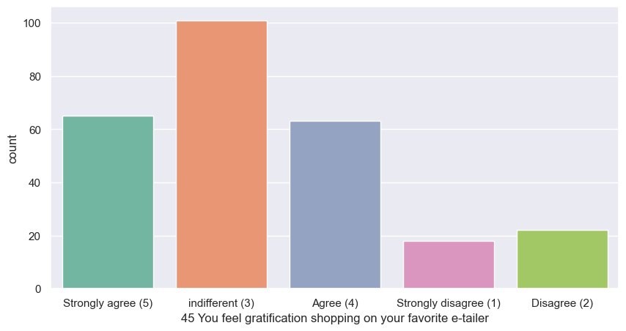
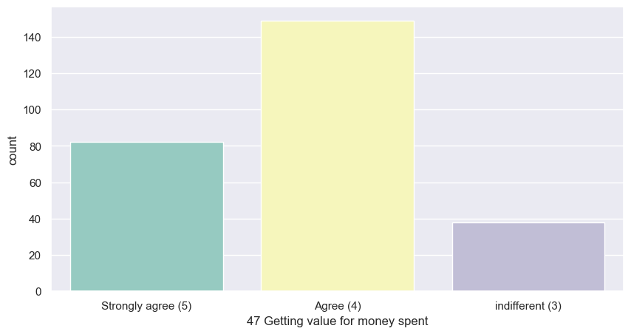
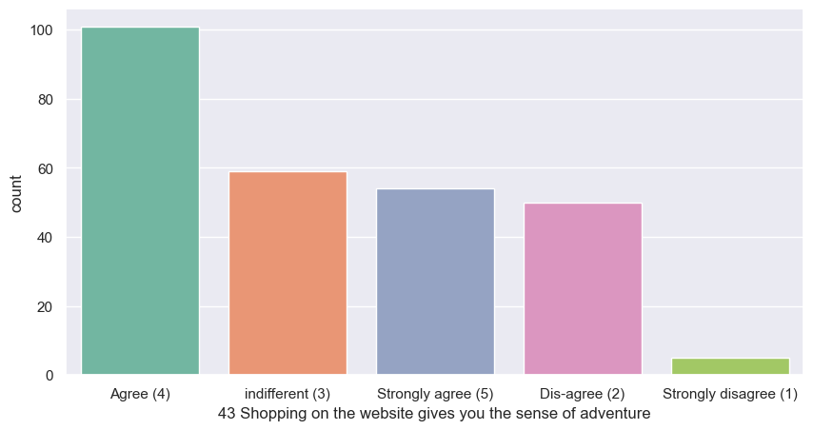
Getting Value for money
spent
Shopping on the website gives you
The sense od adventure
You feel gratification shopping on
your favourite e-tailer
Hedonic Values

Slide 21
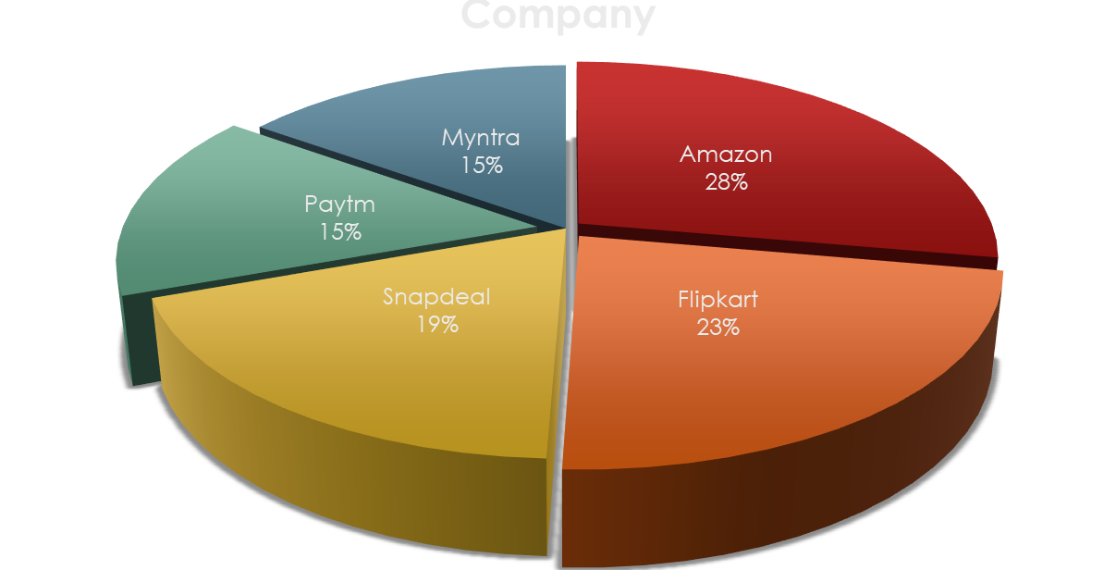
Online retailer preferred:

Slide 22
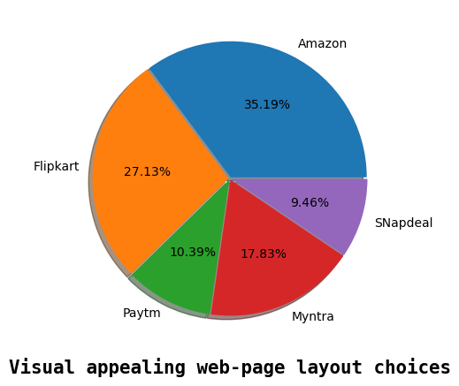
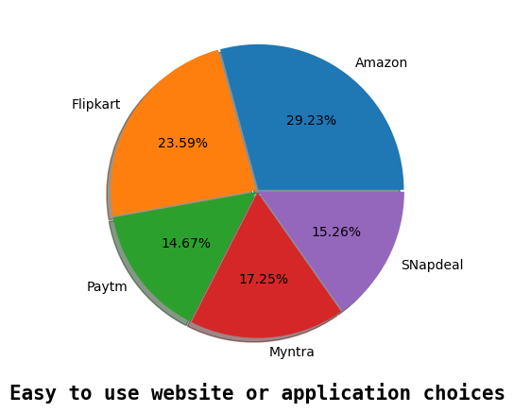
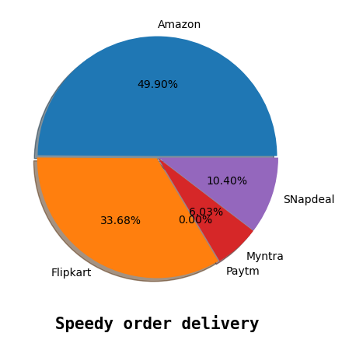

Product Availability :
Conclusion:
Amazon have variety of products with complete, relevant information
Flipkart is on 2nd Choice.
Myntra is on 3rd Choice.
Snapdeal secured 4th position.
Paytm is on 5th position in product availability category.

Slide 23
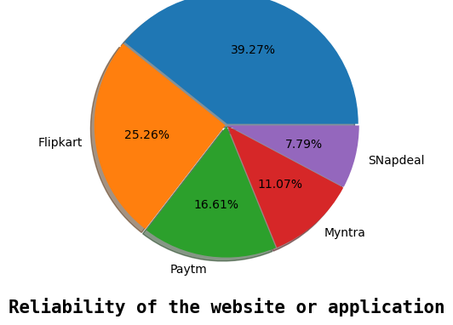
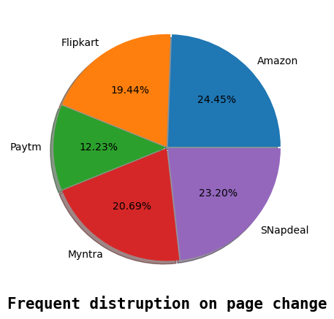
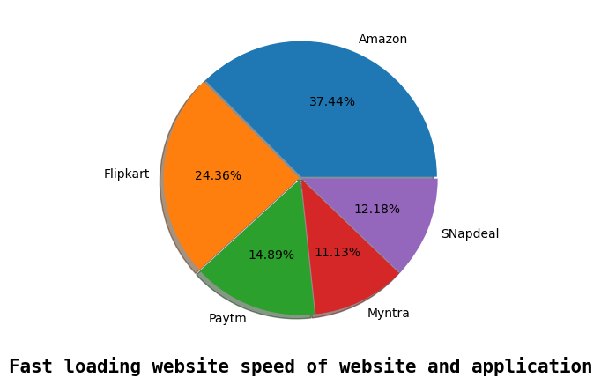
Platform Technical Performance
Conclusion:
Amazon is technically best platform as per customer choices
Flipkart is on the 2nd position in this category
Paytm secured 3rd position on platform stability
Myntra is on 4th position
Snapdeal is on 5th position

Slide 24
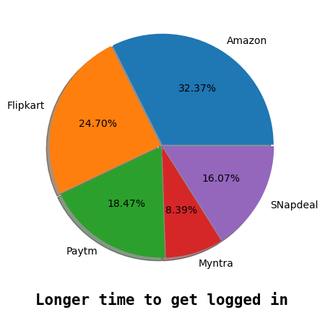
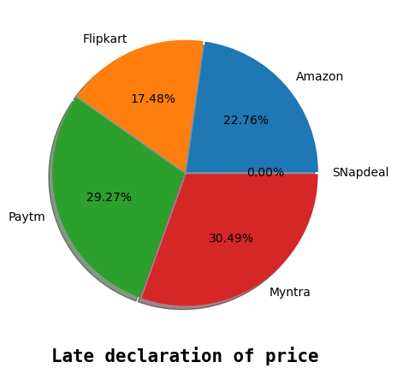
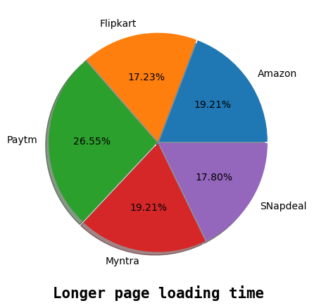
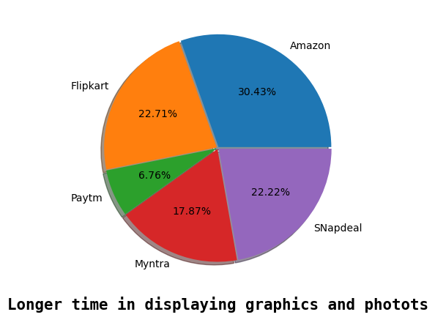
Performance during promotion, sales period
Conclusion:
Amazon is the most favourite and popular
Website for ecommerce but during sales
Period time performance is not much
Good.

Slide 25
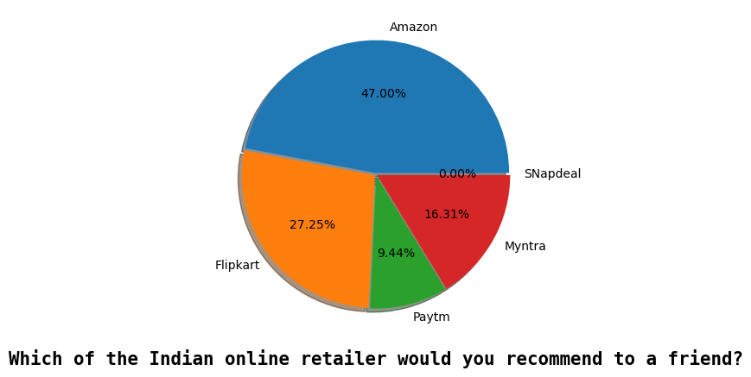
Which of the Indian online retailer would you recommend to a friend?
Conclusion:
Amazon is leading In most of the categories to Customers first
recommendation.

